Slide 1


ASTRA: Intelligent Multi-Cloud Storage
Kimi AI
2025/08/05

Slide 2




01.
The Challenge & Vision
02.
Architecture Deep Dive
03.
CONTENTS
Intelligent Data Logic
04.
Performance & Savings
05.
Roadmap & Differentiators
06.
Go-to-Market & Next Steps

Slide 3



01
The Challenge & Vision

Slide 4

The Cloud Storage Crisis
Organizations drown in petabytes scattered across clouds, with 60-70% of objects in over-priced tiers. The result is runaway spend, risky manual moves, and compliance gaps.
Runaway Spend
Risky Manual Moves
Compliance Gaps
Millions wasted on hot storage for cold data.
Complex, error-prone migrations create downtime.
Fragmented policies lead to audit failures.

Slide 5
The ASTRA Solution
ASTRA delivers autonomous, policy-driven orchestration to eliminate storage woes. It transforms cloud storage into a portable, intelligent utility.
40-60%
Cost Cut
ML-Driven Auto-Tiering
Zero-Downtime Migration
Unified Cost Analytics

Slide 6
02
Architecture Deep Dive

Slide 7
System Architecture: A Unified Orchestration Layer
Web Dashboard (Flask)
Interactive UI + Real-time Analytics
Core Engine Layer
Tiering Engine & Migration Manager
Cloud Abstraction Layer (S3Manager)
AWS S3
GCP Storage
Azure Blob

Slide 8
Component Deep Dive
S3Manager
Tiering Engine
Unified API for authentication, bucket management, and object operations. Handles tier mapping across providers.
Analyzes access patterns (frequency, recency) and calculates cost-benefit for intelligent tier transitions.
Migration Manager
Web Dashboard
Manages parallel, chunked transfers with integrity verification (checksums) and rollback capabilities.
Provides a single pane of glass for visualization, drag-and-drop migration, and cost analytics.

Slide 9
03
Intelligent Data Logic

Slide 10
Auto-Tiering Decision Engine
The engine continuously evaluates objects based on file type, age, and access frequency to propose the most cost-effective storage class.
Hot Data
Warm Data
Cold Data
Active customer transactions
Monthly accessed backups
Logs untouched for 90+ days
STANDARD
STANDARD_IA
GLACIER
$0.023/GB
$0.0125/GB (46% savings)
$0.004/GB (82% savings)

Slide 11
Seamless Cross-Cloud Migration Flow
1. Pre-Migration
2. Chunked Transfer
3. Verification
4. Cleanup
Validate source, destination, and bandwidth.
Stream in 5MB chunks with parallel uploads.
Checksum and size validation for integrity.
Optional source deletion and metadata update.

Slide 12
04
Performance & Savings

Slide 13
Benchmarks: ASTRA vs. Legacy Methods
Traditional Download-Upload
ASTRA Streaming
3x latency: 8 min for 1GB file
2.7x faster: 3 min for 1GB file
OOM errors on large files (10GB+)
Constant memory (5MB chunks)
Single point of failure
99.7% success rate with auto-retry
High memory footprint (full file size)
Achieves 125 MB/s transfer speed

Slide 14
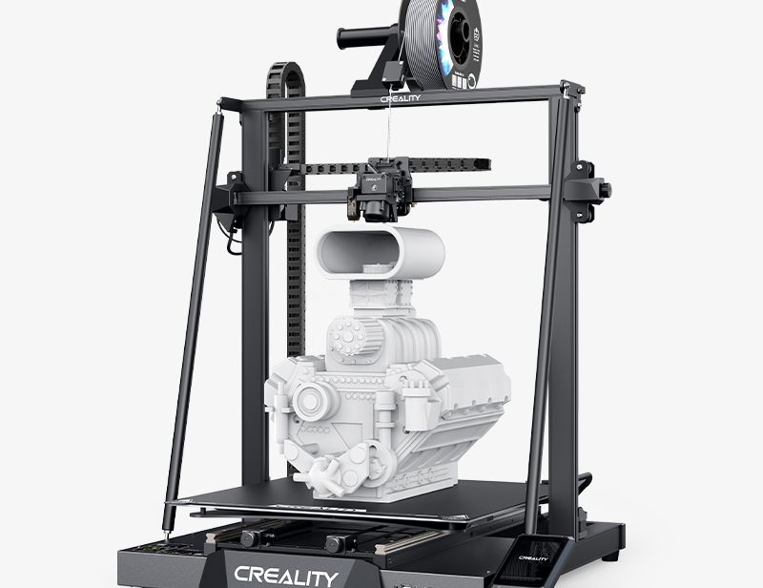
The Business Impact
For a typical enterprise with 500TB of data, ASTRA delivers significant, quantifiable value.
Annual Savings
$145,000
Payback Period
4.1 Months

Slide 15
05
Roadmap & Differentiators

Slide 16
Innovation Roadmap: A Vision for the Future
Phase 2 (1-2 Yrs.)
Phase 1 (6-12 Mo.)
Phase 3 (2-5 Yrs.)
Multi-Region & Governance
ML Integration & Enhanced UX
Autonomous Storage
Global Replication & Edge Caching
GDPR/HIPAA Automation
API Marketplace & SDKs
LSTM Predictive Tiering
Delta Sync & Bandwidth Throttling
Slack/Email Alerts
AI-Driven Self-Optimization
Blockchain Audit Trails
Quantum-Safe Encryption

Slide 17
The ASTRA Advantage: Why We're Different
Feature | ASTRA | AWS Native | Other Competitors
Multi-Cloud Support | Full AWS/GCP/Azure | AWS Only | Limited
Custom Tiering Rules | Fully Customizable | Fixed Algorithm | Basic Rules
Migration Automation | Drag-and-Drop | Manual | CLI Only
Cost Transparency | Real-time Dashboard | Delayed Billing | Monthly Reports

Slide 18
06
Go-to-Market & Next Steps

Slide 19
Deployment Strategy
Risk Mitigation
A staged rollout ensures smooth adoption and minimizes disruption, targeting 30% savings within 90 days.
Data Loss
Mitigation: Checksums, rollback, and backup retention.
1
Pilot: Deploy in a sandbox with 10TB of test data.
API Limits
Mitigation: Exponential backoff and request queuing.
2
Staged Rollout: Migrate non-critical workloads and monitor.
Cost Overruns
3
Full Production: Enable automation and CI/CD integration.
Mitigation: Real-time budget alerts and spending caps.

Slide 20
Ready to Revolutionize Your Cloud Storage?
Join the movement towards autonomous, multi-cloud storage that is cheaper, safer, and infinitely scalable.
Try the Demo
https://github.com/AnshNohria/Astra

Slide 21

THANK YOU FOR READING！
Kimi AI
2025/08/05

